Slide 1
Hardware/Software Platforms Project Presentation
Maze Car
Nathan SEUTIN Nathan.seutin@student.umons.ac.be
Victor DELVIGNE Victor.Delvigne@student.umons.ac.be

Slide 2
Introduction

Slide 3
Introduction
Tutorial: Arduino Car Park Sensor

Slide 4
Introduction
Tutorial: Arduino Car Park Sensor
From the tutorial to final project

Slide 5
Introduction
Tutorial: Arduino Car Park Sensor
From the tutorial to final project
Final project: Maze Car

Slide 6
Introduction
Tutorial: Arduino Car Park Sensor
From the tutorial to final project
Final project: Maze Car
Conclusion & Improvements

Slide 7
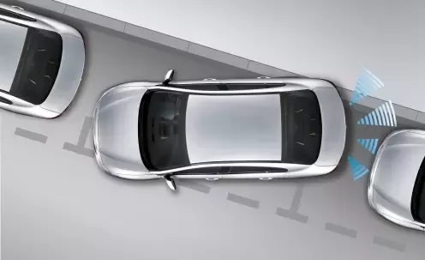
Tutorial: Arduino Car Park Sensor
Goals
Easy and concrete implementation

Slide 8
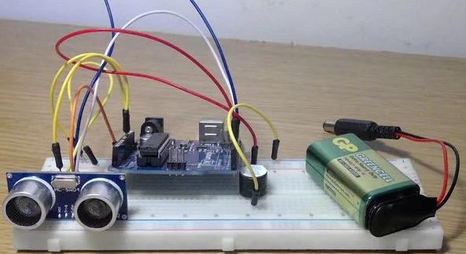
Tutorial: Arduino Car Park Sensor
Goals
Build a system able to emit a sound at given frequency in function of the distance between the sensor and the obstacle

Slide 9
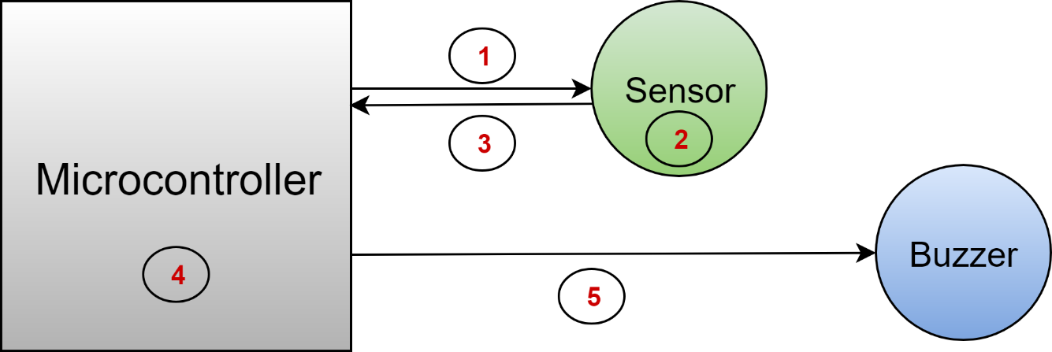
Tutorial: Arduino Car Park Sensor
Components
Programmable microcontroller
ESP8266 LoLin
Ultra sound sensor
1x SRF-02 (I²C)
Buzzer

Slide 10
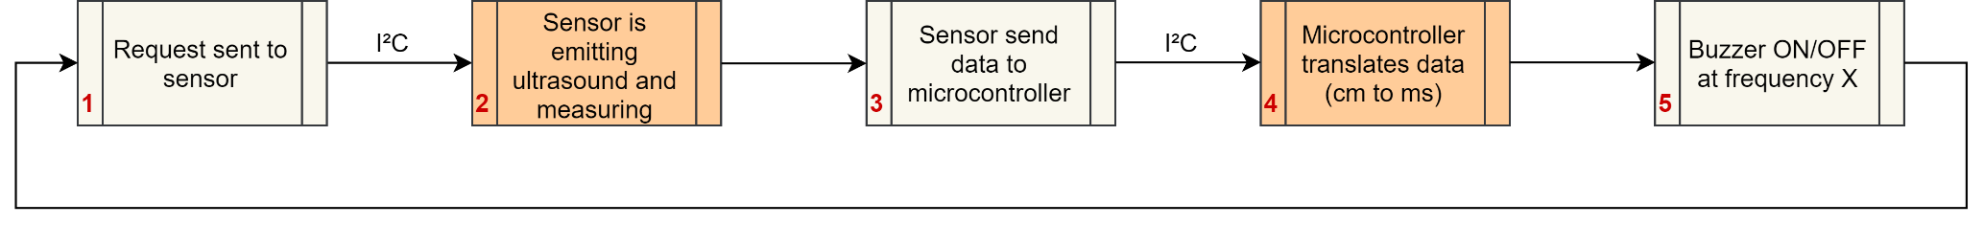
Tutorial: Arduino Car Park Sensor
Components
Programmable microcontroller
ESP8266 LoLin
Ultra sound sensor
1x SRF-02 (I²C)
Buzzer

Slide 11
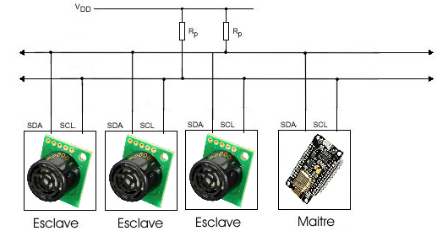
Tutorial: Arduino Car Park Sensor
I²C buses between microcontroller and ultra-sound sensor

Slide 12
Tutorial: Arduino Car Park Sensor
Simple algorithm
Initiation of I²C communication
Reading the input (in centimeters)
Conversion in time for buzzer frequency

Slide 13
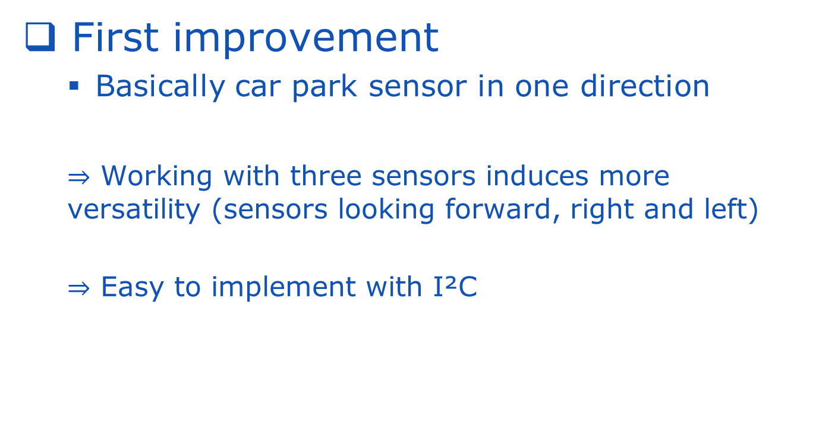
Tutorial: Arduino Car Park Sensor
First improvement
Basically car park sensor in one direction
$⇒$ Working with three sensors induces more versatility (sensors looking forward, right and left)
$⇒$ Easy to implement with I²C

Slide 14
From the tutorial to final project
Project already ended ?
Let’s create an autonomous car !

Slide 15


Slide 16
Maze Car
Goals
The Maze Car has to get out from a maze, from the beginning to the end
Capability to solve complicated situations (one way, choice between 3 directions, …)

Slide 17
Maze Car
Goals
The Maze Car has to get out from a maze, from the beginning to the end
Capability to solve complicated situations (one way, choice between 3 directions, …)
NB: The environment is precisely defined (distances between walls => need for calibration…)

Slide 18
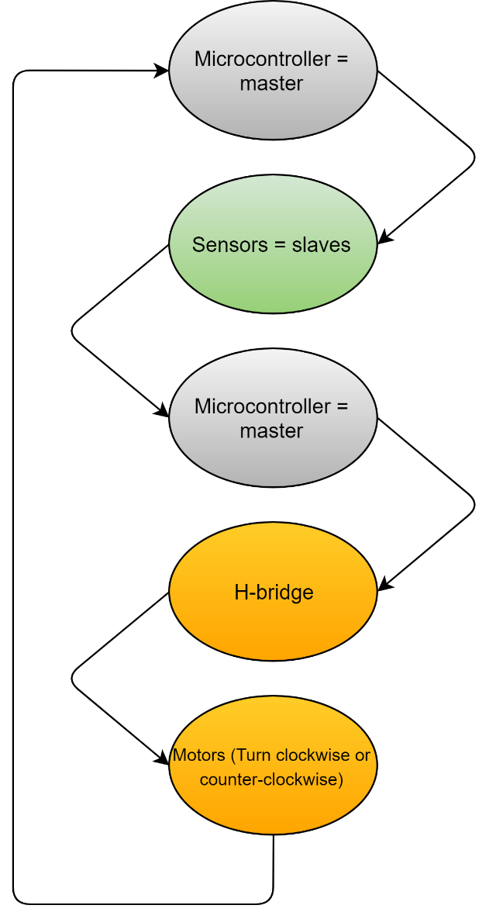
Maze Car
Components
Programmable microcontroller
ESP8266 LoLin
3 x Ultra-sound sensor
SRF-02 (I²C)
5V battery
Pololu platform
2 x DC motors (dep, car size)
H-bridge (DC motors)

Slide 19

Maze Car
How to easily control two motors?

Slide 20
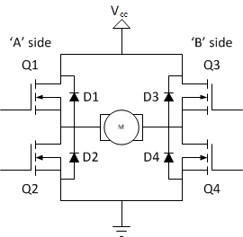


Maze Car
Solution is the “H-bridge”
Each motor is controlled with PWM signals
Example 2
Example 1
PWM
Duty cycle 2*x
PWM
Duty cycle x

Slide 21
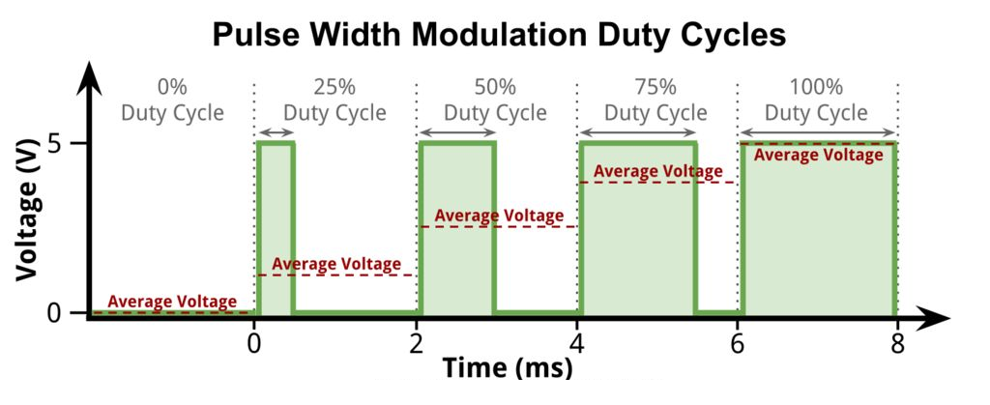
Maze Car
Solution is the “H-bridge”
Each motor is controlled with PWM signals

Slide 22
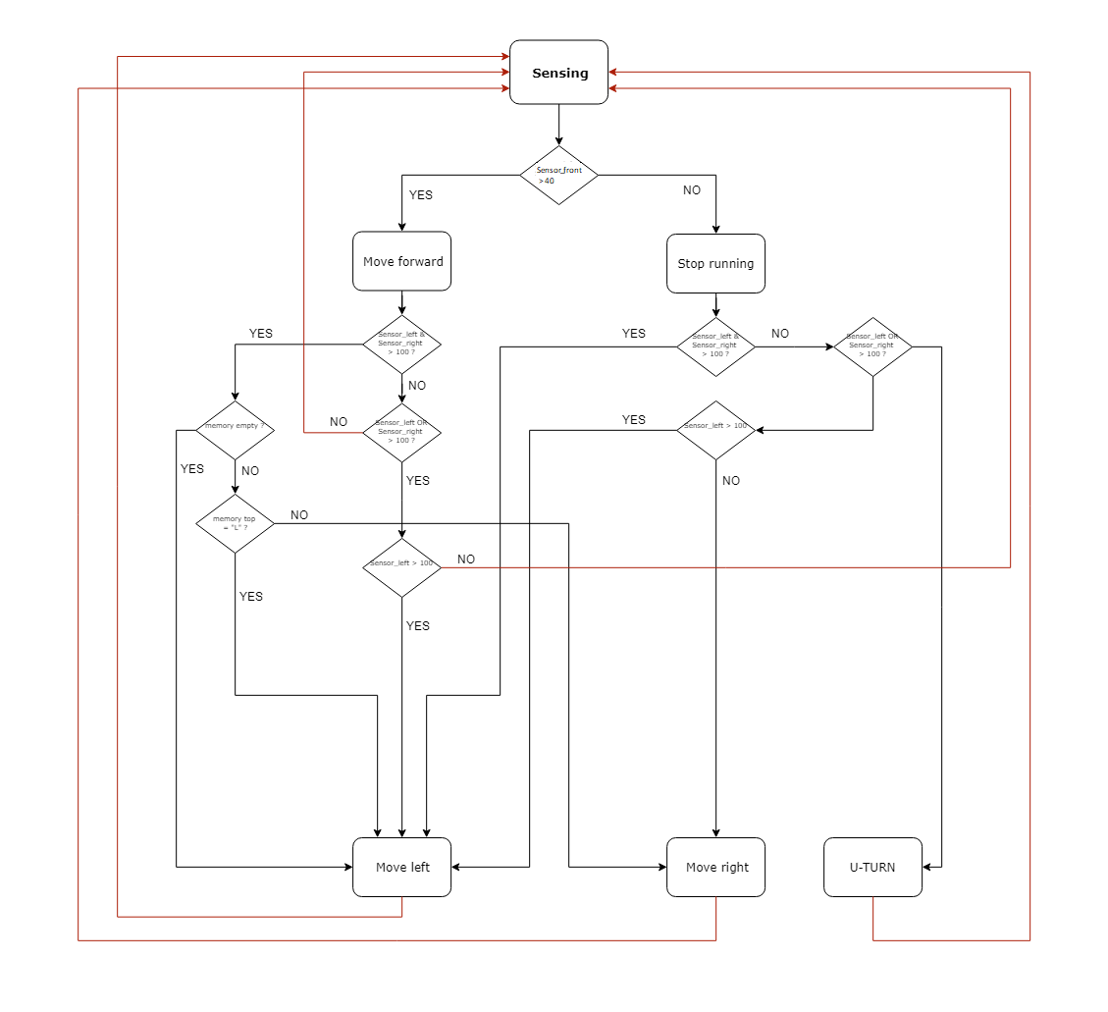
Maze Car
Global algorithm (detection + decision)

Slide 23
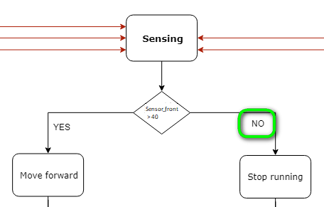
Maze Car
Example of a left turn

Slide 24
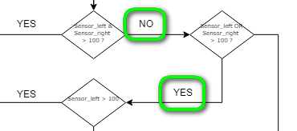
Maze Car
Example of a left turn

Slide 25
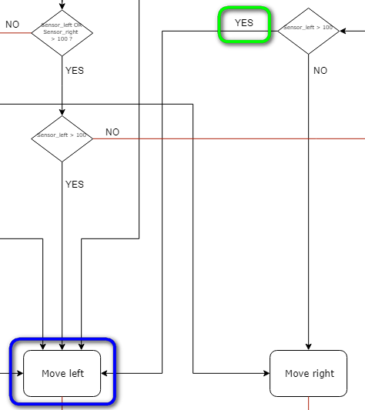
Maze Car
Example of a left turn

Slide 26
Maze Car
Second improvement
Implementation on a platform

Slide 27
Maze Car
Second improvement
Implementation on a platform
Use of a battery

Slide 28
Maze Car
Second improvement
Implementation on a platform
Use of a battery
Autonomous and intelligent car

Slide 29
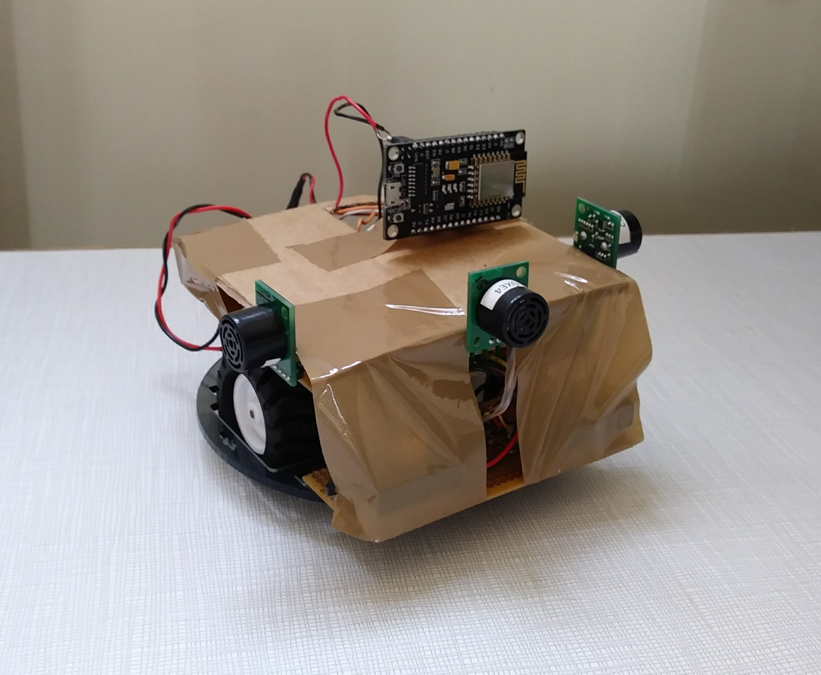
Maze Car
Results

Slide 30
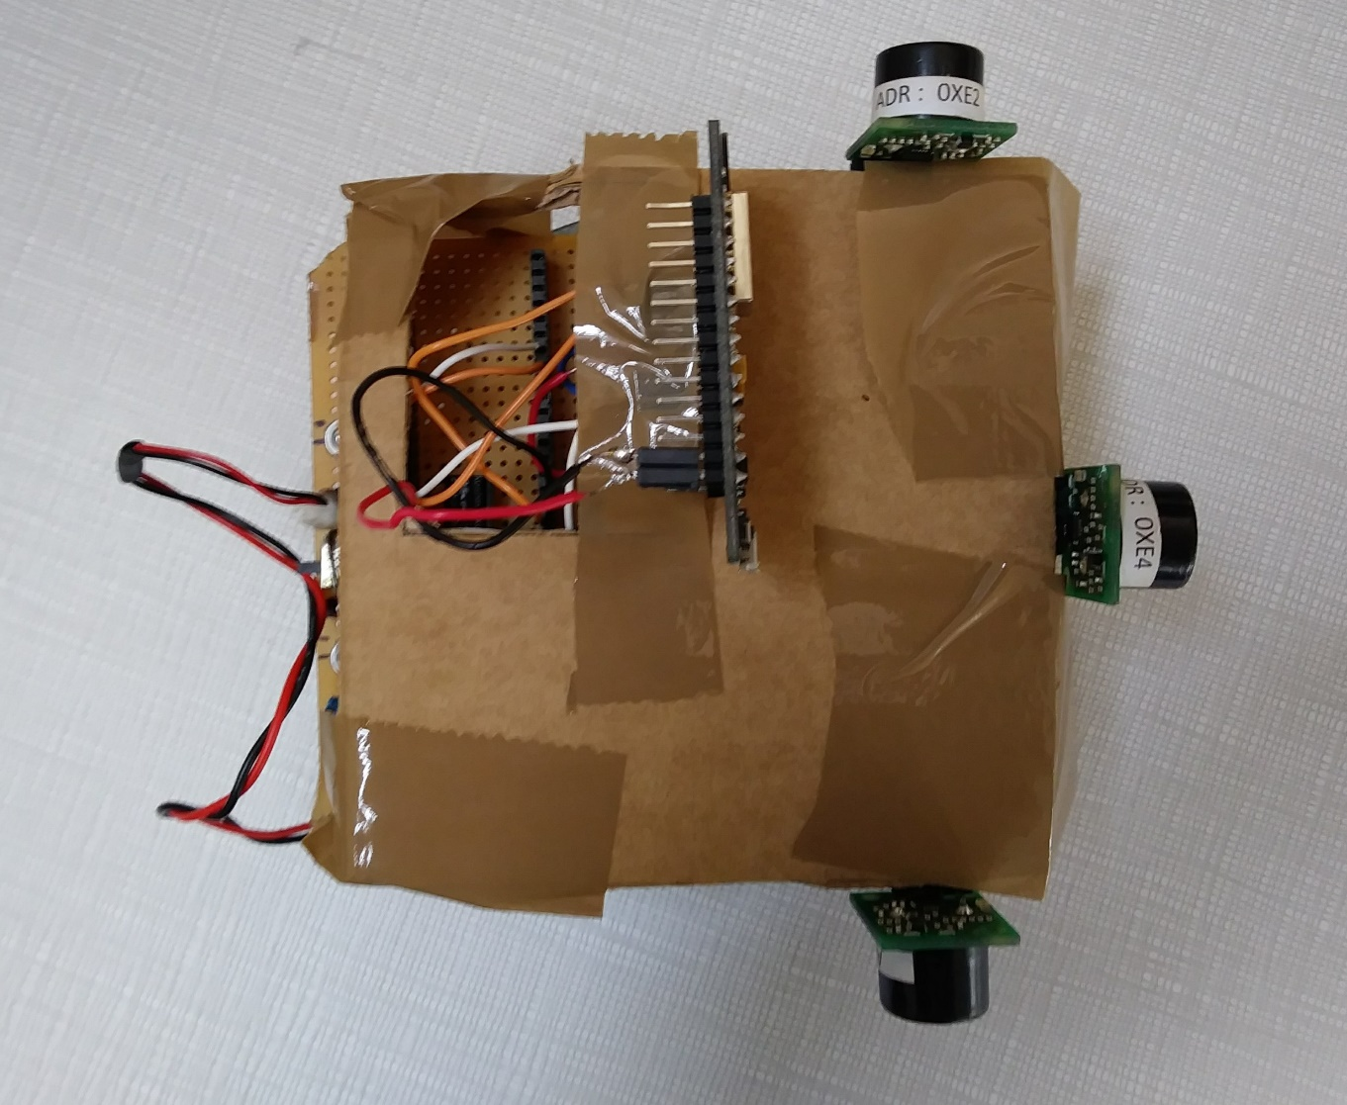
Maze Car
Results

Slide 31
Maze Car
Results
Efficiency (+-)
Why?

Slide 32
Maze Car
Results
Efficiency (+-)
Why?
Autonomy (-)
Why?

Slide 33

Maze Car
Video

Slide 34
Conclusion & Improvements
Strategy ?
Time necessary to achieve this project ?
Hardware part improvements ?
Software part improvements ?

Slide 35
Thanks for listening !

